Slide 1
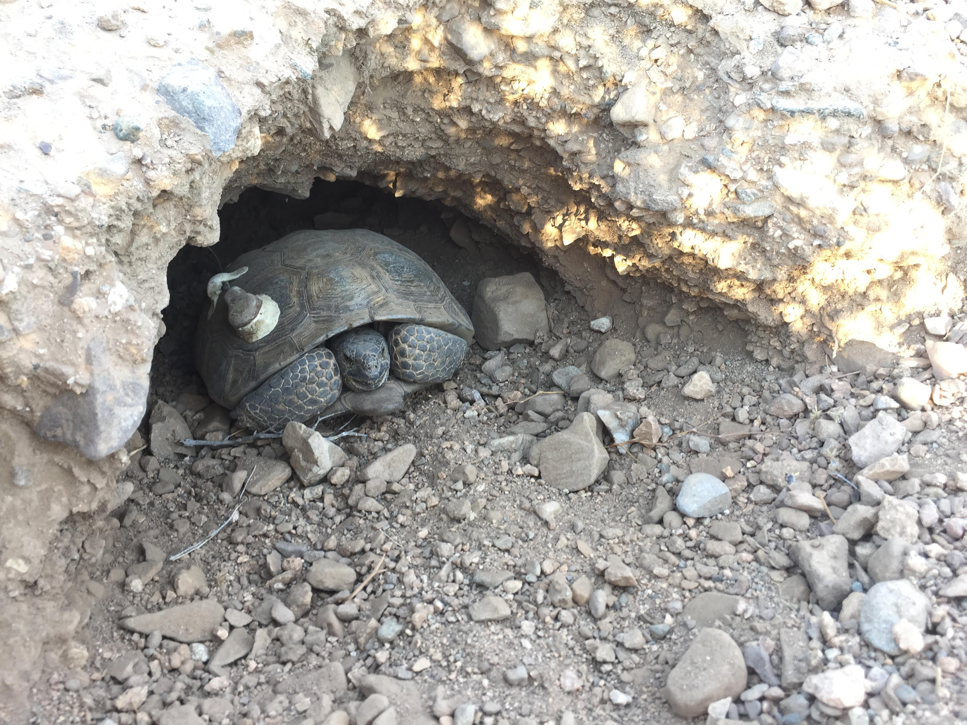




How long can Desert Tortoises, Gopherus agassizii, hide in their burrows from climate change?
NASA PRESENTOR: Jenna Norris
MENTOR: Dr. Jeffrey E. Lovich
Notes:
Today I want to talk to you about the possible affects of climate change on desert species, particularly related to the desert tortoise, Gorpherus agassizii

Slide 2
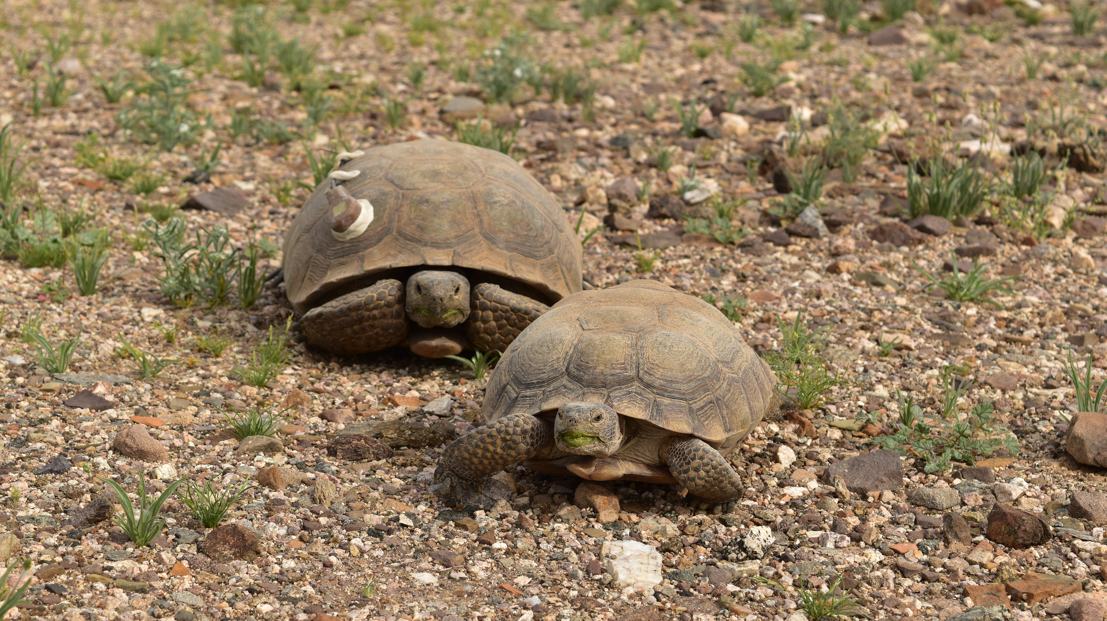
Notes:
gopherus agassizii distribution
KEY CONCEPTS
1. Tortoise population continue to decline range wide despite the fact that they were listed at threated in 1990
2. Tortoise are model organisms for climate change effects
*”cold blooded” or ectotherms, so do not have ability to regulate body temperature by metabolic processes

Slide 3
HOURS OF ACTIVITY VS HOURS OF RESTRICTION
Ectotherm survival depends on a delicate balance between hours available for activity and hours of restriction
  Hours of restriction – surface temperatures above operative temperatures
    Critical Thermal Maximums (CTM) = 41.3 ºC
Reduction in hours of activity may leave tortoises unable to meet all of their crucial biological needs
  Past a tipping point for survival.
Notes:
In ectotherms, metabolism, growth, survival, and reproduction depend in part on hours available for activity (ha); that is, when operative temperatures (Te) are warm enough for surface activity and foraging, but also constrained by hours of restriction, when midday surface temperatures exceed acceptable limits and force them into burrows or rock shelters (Jeff et. al. SCIENCE paper )
Add from lizard erosion paper by rafa
CTM = 41.3

Slide 4
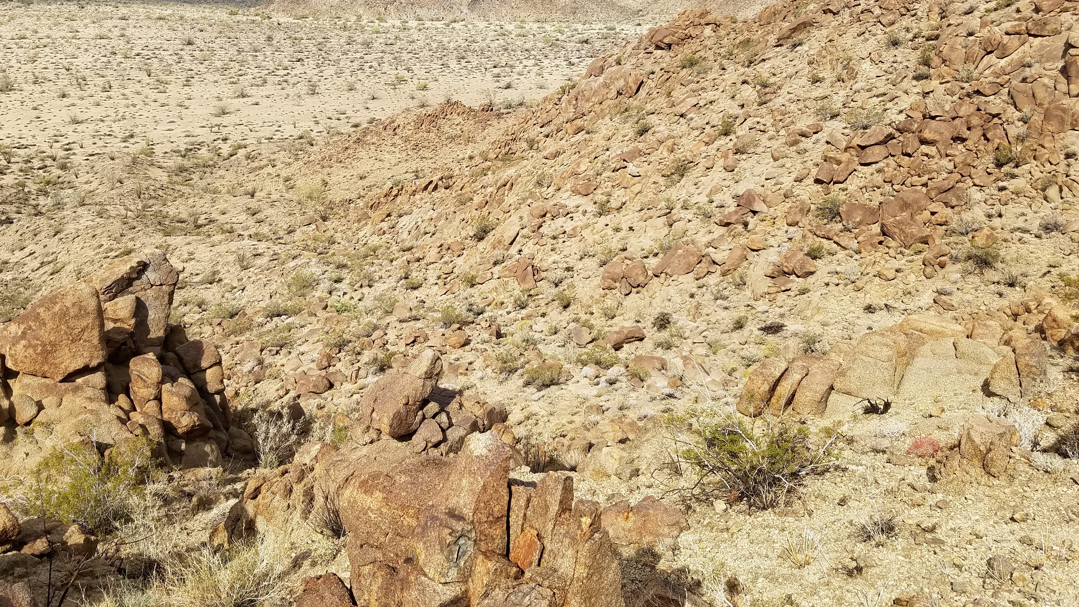
CLIMATE CHANGE
Southwestern United States disproportionally subjected to trends in rising temperatures and increased aridity
Global Circulation Models (GCM)
  Projected temperature increase of 3.5–4°C within the next 60–90 years
Predicted to affect distribution and survival of desert tortoise
Notes:
Studies modeling the affects of global climate change have concluded that during the 21st century the southwestern United States will be disproportionally subjected to trends in rising temperatures and increased aridity
Global circulation models (GCM) of future climates predict extreme change for the Southwestern United States
Temperatures are projected to increase 3.5–4°C within the next 60–90 years while precipitation is projected to decline by 5–20 %
Numerous studies have concluded that the distribution and concentration of particularly sensitive species, such as the desert tortoise Gopherus agassizii, will be both directly and indirectly impacted by the warming temperatures and decreased precipitation predicted to occur over the course of the next century.

Slide 5
IMPACTS OF CLIMATE CHANGE
ON DESERT TORTOISE
Thermal constraints on activity and microhabitat utilization
  Spend up to >98% of their annual activity cycle below ground due to harsh desert conditions and <2% of time active at the surface .
Environmental Sex Determination
    Limit production of male hatchlings
Notes:
Thermal constrains on activity and microhabitat utilization are fundamental pieces of a large puzzle describing our understanding of observed patterns of grown, reproduction and health of individuals, and patterns of distribution and abundance
Time below CTMS’s severely limiting their activity period due to the harsh conditions of on the desert surface.
If the warming trend continues and precipitation levels simultaneously lower or become more variable, studies have shown that G. agassizii can only endure droughts for so long before they perish.
decreased precipitation is directly correlated with decreased annual food plant production, further restricting tortoises’ access to an already limited food source.
G. agassizii have environmental sex determination and some studies suggest warming temperatures might limit natural production of male hatchlings in turtles.
skew primary sex ratios of hatchlings to all females thus denying populations of reproductive opportunities over the long term
Add?
After two years without water studies show desert tortoise populations suffer high mortality rates

Slide 6
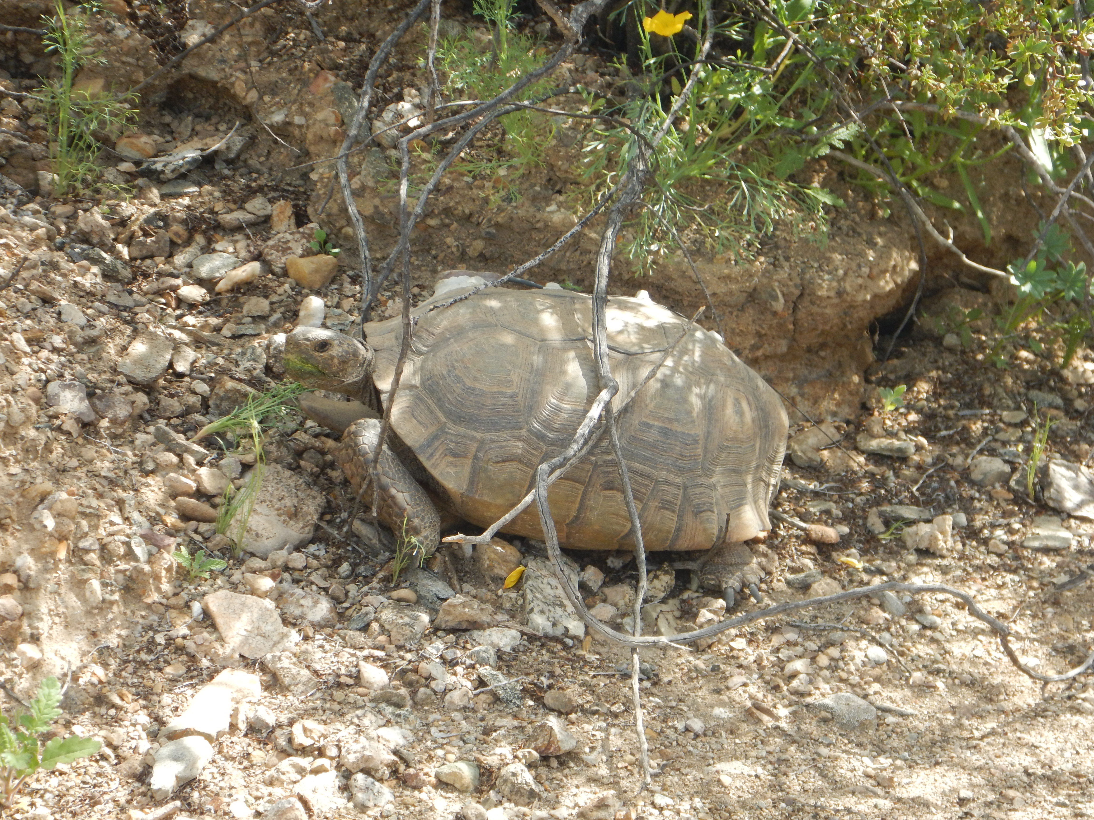
POSSIBLE RESPONSES?
*None
*Extirpation/extinction
*Evolution
–wider threshold temperature for sex determination
*Adaptation
- shift elevation range upward
- shift geographic range
- shift nesting season
- change nest depth/location
Notes:
NONE: the climate changes we see into the foreseeable future will have no effect on population persistence of tortoises. In other words, tortoises may already have the "flexibility" to just adapt to a small increase in average temperature
EXTIRPATION/EXTINCTION: it is possible that the projected increases in the foreseeable future will be too fast or too large for tortoise populations to withstand (ie. Problems mentioned in previous slide)
ADAPATION:
ELEVATION: three types of habitat Barrows predicted would be available for tortoises: places that are not suitable for tortoises today or in the future, places that will be suitable in the future, and places that are suitable now AND in the future. (mostly show shift upwards in elevation)
GEOGRAPHIC RANGE: The paleo data for tortoises shows that range adjustments occurred before.
fossilized and subfossilized burrows, nests and shells of tortoises near the Colorado River in Blythe. Those areas are generally too low and hot for tortoise populations today but they were there not long ago: a preview of what is to come if the future warming projections are correct.
NESTING SEASON: They could nest earlier to avoid higher temps
NEST DEPTH: deeper into the cooler recesses of the burrows
Make fonts same

Slide 7
IMPORTANCE
Desert species already struggling to survive in the harsh desert conditions where climate change is predicted to have its most severe impact
Respond quickly enough to a rapidly warming climate?
  evolution would have to occur at a rate that is >10,000 faster
Habitat fragmentation limits ability to track climatic niches.
Notes:
multiple studies show animals may not be able to respond quickly enough. One study cites that in order for species to adapt to the rate of changing climates, evolution would have to occur at a rate that is >10,000 faster than what is normal. Even if this accelerated rate of evolution was achieved, habitat fragmentation limits the ability of G. agassizii to track climatic niches.
Southwestern ecosystems will invariably respond in different ways to the increased aridity, but many desert species are already struggling to survive in the harsh desert conditions where climate change is predicted to have its most severe impact

Slide 8
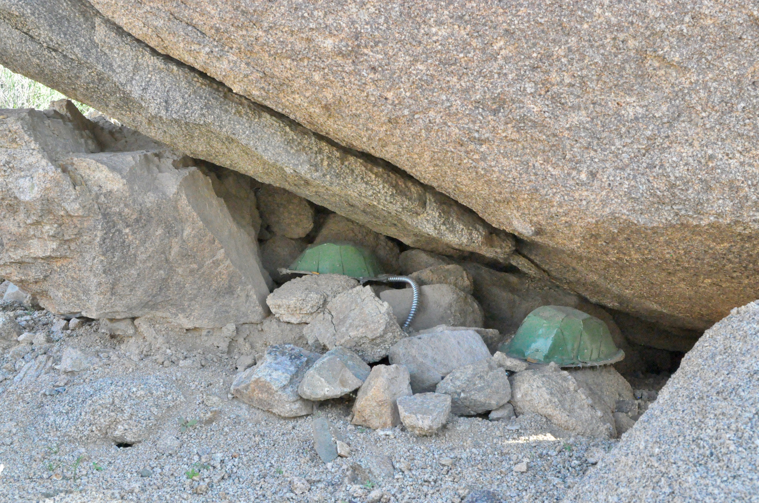
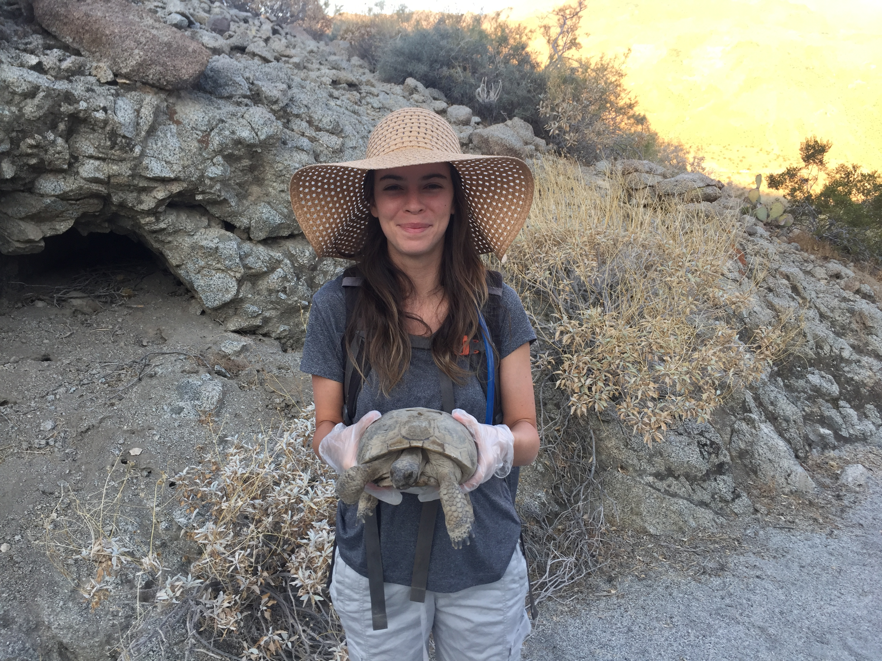
DATA COLLECTION
Study site located in the the southernmost boundary of Joshua Tree National Park in the Sonoran Desert of California.
Data loggers designed to mimic thermal dynamics of desert tortoises
  Collected air temps every 15 minutes under current conditions
Data loggers placed in various tortoise microhabitats; in and under bushes, trees and under rock shelters and burrows

Slide 9
PERCENT OF OBSERVATIONS ABOVE CTM
CLIMATE | MINIMUM | MAXIMUM | MEAN
CURRENT CONDITIONS (2016-2017) | 0% | 9.1401% | 2.576%
FUTURE CONDITIONS (+4 °C) | 0% | 13.3041% | 6.449%

Slide 10
CONCLUSION
Future climatic conditions that further restrict hours available to tortoises for above ground activity will have a potentially major impact on their surface activity and possibly their survival rates
Notes:
~ harvest resources
~ produce eggs
~ find mates
In conclusion, because tortoises spend greater then 98% of time in burrow due to climate, predator avoidance, nesting and, lack of food and water availability.

Slide 11
ACKNOWLEDGEMENTS
MENTOR: DR. JEFFREY LOVICH FROM U. S. GEOLOGICAL SURVEY
NAU NASA SPACE GRANT PROGRAM

